Slide 1
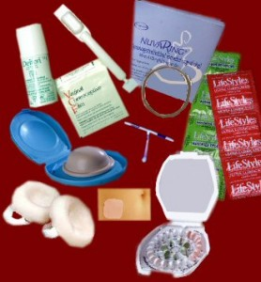
CONTRACEPTIVE METHODS
What are the Contraceptive Methods?
INTRODUCTION
These are methods that prevent women get pregnant, and are a good aid for family planning.
WHAT IS FAMILY PLANNING?
It is a process in which the woman decides how many children she wants and when he wants them. It starts when a woman starts having sex and remains throughout their reproductive years (until menopause).
A good family planning requires good communication between the couple, and it receives education about contraception, maternal and child health, and related topics.

Slide 2


Task
WHICH ARE THE CLASS OF THE CONTRACEPTIVE METHODS ?
In this unit you will learn to search for information through the Internet search tools: all contraceptive methods that exist, what they are, when it is advisable to use them, so that we serve, which are effective and which are not.

Slide 3


Activities
PROCESS
Write the types of contraceptive methods that you found.
You Draw which you interested.
Read the information about these methods in the next page:
http://www.sec.es/informacion/guia_anticonceptivos/index.php

Slide 4


Answer the following questions in your notebook.
PROCESS
ACTIVITY 2
*Why the rhythm method is not completely effective?
* What is the importance of emergency contraception?
*Why undergo surgical methods should be a well thought decision?
*How important are contraceptive measures?

Slide 5

Explain how do the following physical contraceptives work.
ACTIVITY 3
PROCESS
condoms or condoms
Diaphragms
Intrauterine Devices

Slide 6
Explain in your notebook :
PROCESS
You gonna ask a health information center about
contraceptive methods.
What did you learn?
Print this exercise

Slide 7
Activity 1 = 2 points (Each Question)
Activity 2 = 2 points (Each Question)
Activity 3 = 5 Points In the Box.
Explain in your Book = 3 points.
Information =5 points.
Print Exercise = 2 Points
EVALUATION
 | EXCELLENT | VERY GOOD | GOOD | NEEDS IMPROVEMENT | INSUFICIENT
Points | 40 to 50 | 31 to 40 | 21 to 30 | 11 to 20 | 10

